Slide 1
PREDICTIVE MODEL ON CUSTOMERS BUYING HOLIDAY OF BRITISH AIRWAYS
A Logistic Regression Algorithm Approach

Slide 2
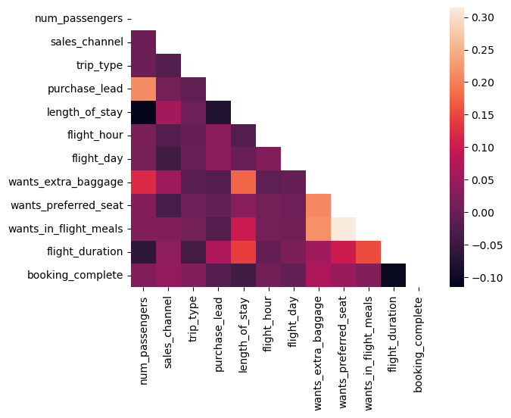
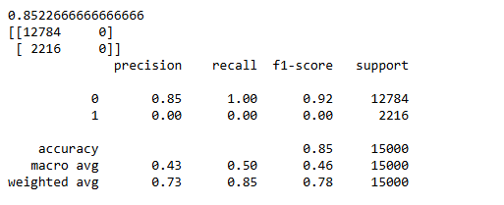
Results
Feature Analysis
Positive Correlations:
There are notable positive correlations between variables like length_of_stay and flight_duration, suggesting that as the length of stay increases, flight durations may also tend to be longer.
The desire for features like wants_preferred_seat, wants_extra_baggage, and wants_in_flight_meals appears to have some positive correlation with the likelihood of booking_complete.
Negative or Weak Correlations:
Most features seem to have relatively weak correlations with each other, indicated by darker colors.
Variables like sales_channel and trip_type do not show strong correlations with other features.
Key Focus Areas:
The correlation between booking_complete and variables such as wants_preferred_seat or wants_in_flight_meals may indicate potential areas of influence for marketing or upsell strategies.
Further analysis could reveal which features most significantly impact booking completion.
Model Evaluation and Outcome
The model can be said to fit well with the dataset with an accuracy and precision of 85% , The F1 score also 0.92 shows that the model covers 92% of the whole dataset.

